Slide 1
10 Boolean logic
1 Identify and use the standard symbols for logic gates
2 Define and understand the functions of the logic gates
– NOT
– AND
– OR
– NAND
– NOR
– XOR (EOR)
– the binary output produced from all the possible binary inputs
NOT is a single input gate
All other gates are limited to two inputs
Circuits must be drawn for the statement given, without simplification
Logic circuits will be limited to a maximum of three inputs and one output
An example truth table with three inputs, for completion:
Use logic gates to create given logic circuits from a:
problem statement, logic expression, truth table
Complete a truth table from a:
problem statement, logic expression, logic circuit
Write a logic expression from a: problem statement, logic circuit, truth table

Slide 2
Today
1 Identify and use the standard symbols for logic gates
2 Define and understand the functions of the logic gates
– NOT
– AND
– OR
– NAND
– NOR
– XOR (EOR)
– the binary output produced from all the possible binary inputs
NOT is a single input gate
All other gates are limited to two inputs
Circuits must be drawn for the statement given, without simplification
Logic circuits will be limited to a maximum of three inputs and one output
An example truth table with three inputs, for completion:
Use logic gates to create given logic circuits from a:
problem statement, logic expression, truth table
Complete a truth table from a:
problem statement, logic expression, logic circuit
Write a logic expression from a: problem statement, logic circuit, truth table
Understand: What is a logic gate
Able: Draw truth tables
Answer: Which gate has only 1 input

Slide 3
1.3.1 – Logic Gates
Use Logic Gates to create electronic circuits
Understand and define logic gates
AND
OR
NOT
NAND
NOR
XOR
EOR
Truth Tables

Slide 4
What is a logic gate?
Why do computers use binary?
Because electricity can be either on or off, 1 or 0
But you must control the flow of electricity
You use logic gates to SHOW how you will control the flow of electricity
You’ll do this in Physics also.

Slide 5
6 types
AND
OR
NOT
NAND
NOR
XOR (sometimes called EOR)

Slide 6
AND
Two inputs
One output
Input 1 AND Input 2 must be on for Output to be ON
Written as A . B = Output
Input A | Input B | Output
0 | 0 | 0
0 | 1 | 0
1 | 0 | 0
1 | 1 | 1

Slide 7
OR
Two inputs
One output
Input 1 OR Input 2 must be on for Output to be ON
Written as A + B = Output
(yes I know using + is stupid for OR)
Truth Table
Input A | Input B | Output
0 | 0 | 0
0 | 1 | 1
1 | 0 | 1
1 | 1 | 1

Slide 8
NOT
ONE inputs
One output
If Input in OFF then output is ON
If Input is ON then output is OFF
Written as Ā
Input A | Output
0 | 1
1 | 0

Slide 9
Quick Quiz
Name 2 logic gates
Name 2 more
And 2 more please
Why do we use logic gates?
Which gate has two inputs?
Which gate has one input
What does + mean?
Which gate needs to have input 1 and Input 2 on for output to be on?
Which gate has one output?
Which gate is simply the opposite of the input?
What are the names of the table?

Slide 10
NAND
Stands for NOT AND
Two Inputs
One Output
Output is ON unless both inputs are ON
Written as A . B = Output
Input A | Input B | Output
0 | 0 | 1
0 | 1 | 1
1 | 0 | 1
1 | 1 | 0

Slide 11
NOR
Stands for NOT OR
Two Inputs
One Output
If any Input is ON then output is OFF
Written as A + B = Output
Input A | Input B | Output
0 | 0 | 1
0 | 1 | 0
1 | 0 | 0
1 | 1 | 0

Slide 12
XOR or EOR
Stands for Exclusive OR
Two Inputs
One Output
If the Inputs are the same then then output is OFF
Written as A B
Input A | Input B | Output
0 | 0 | 0
0 | 1 | 1
1 | 0 | 1
1 | 1 | 0

Slide 13
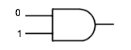

Slide 14
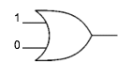

Slide 15
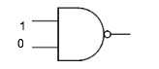

Slide 16
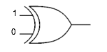

Slide 17
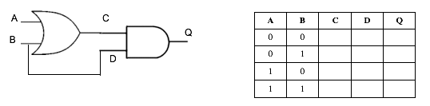

Slide 18
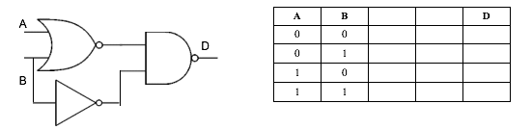

Slide 19
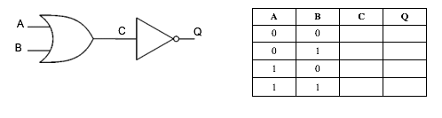

Slide 20
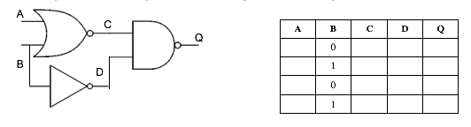

Slide 21
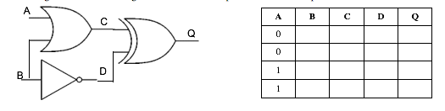

Slide 22
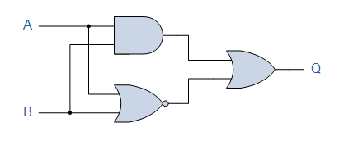

Slide 23
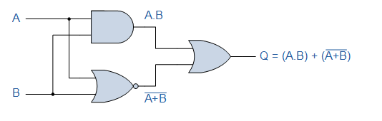

Slide 24
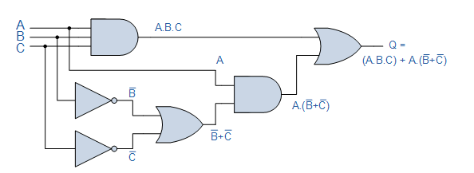

Slide 25
From the exam paper
Draw the logic circuit and truth table for:

Slide 26


Slide 28
Logic circuit and truth table

Slide 29


Slide 30
Answer

Slide 31
Logic circuit and truth table

Slide 32
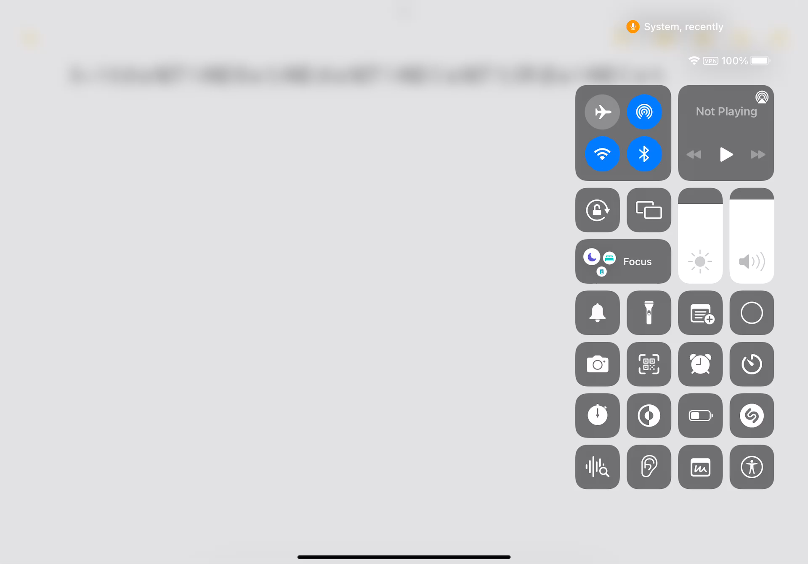

Slide 33
Answer

Slide 34
Truth table for:

Slide 35
Answer

Slide 36
Test Others
https://academo.org/demos/logic-gate-simulator/
Draw a logic circuit
Make it complicated
Swap places with another student
The other student must write a truth table for YOUR circuit

Slide 37
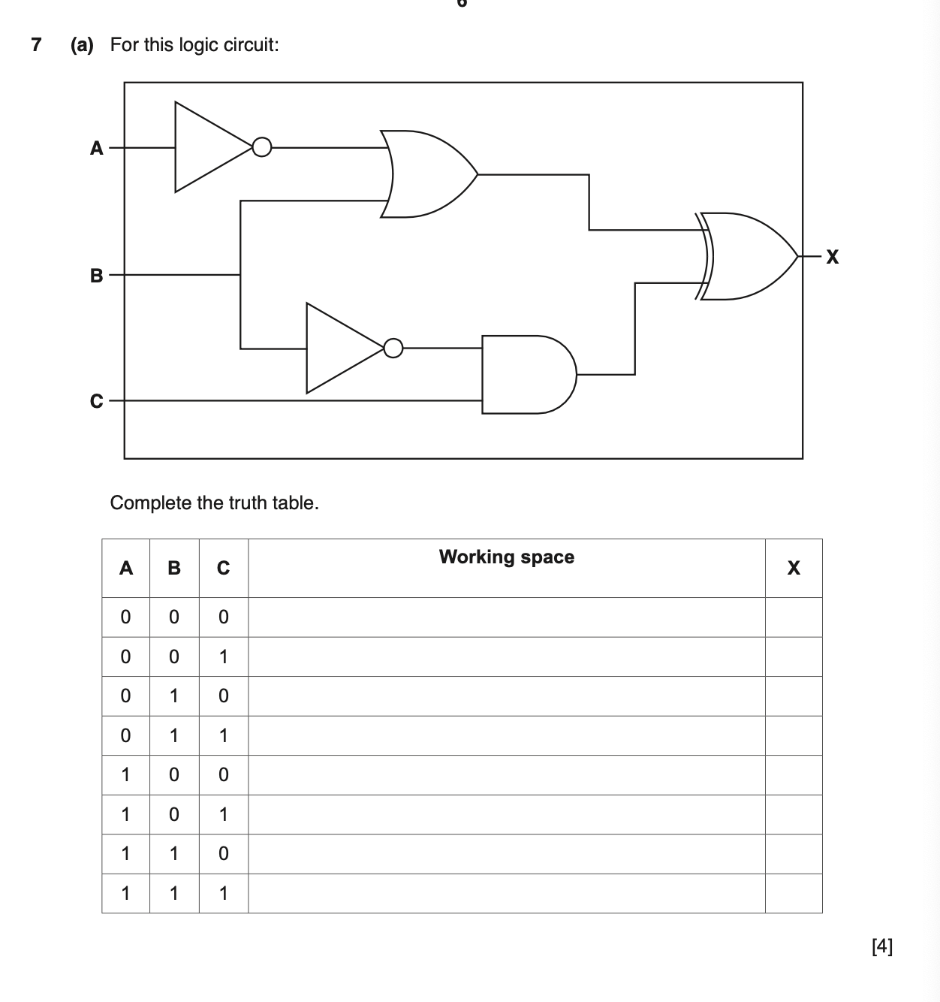
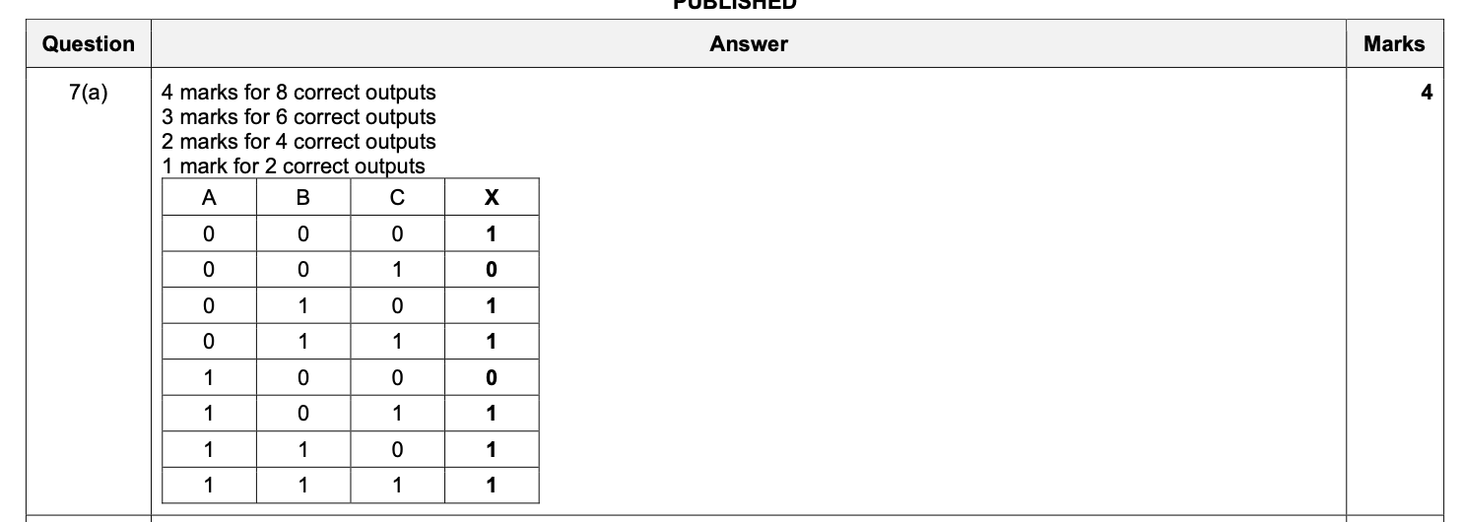

Slide 38
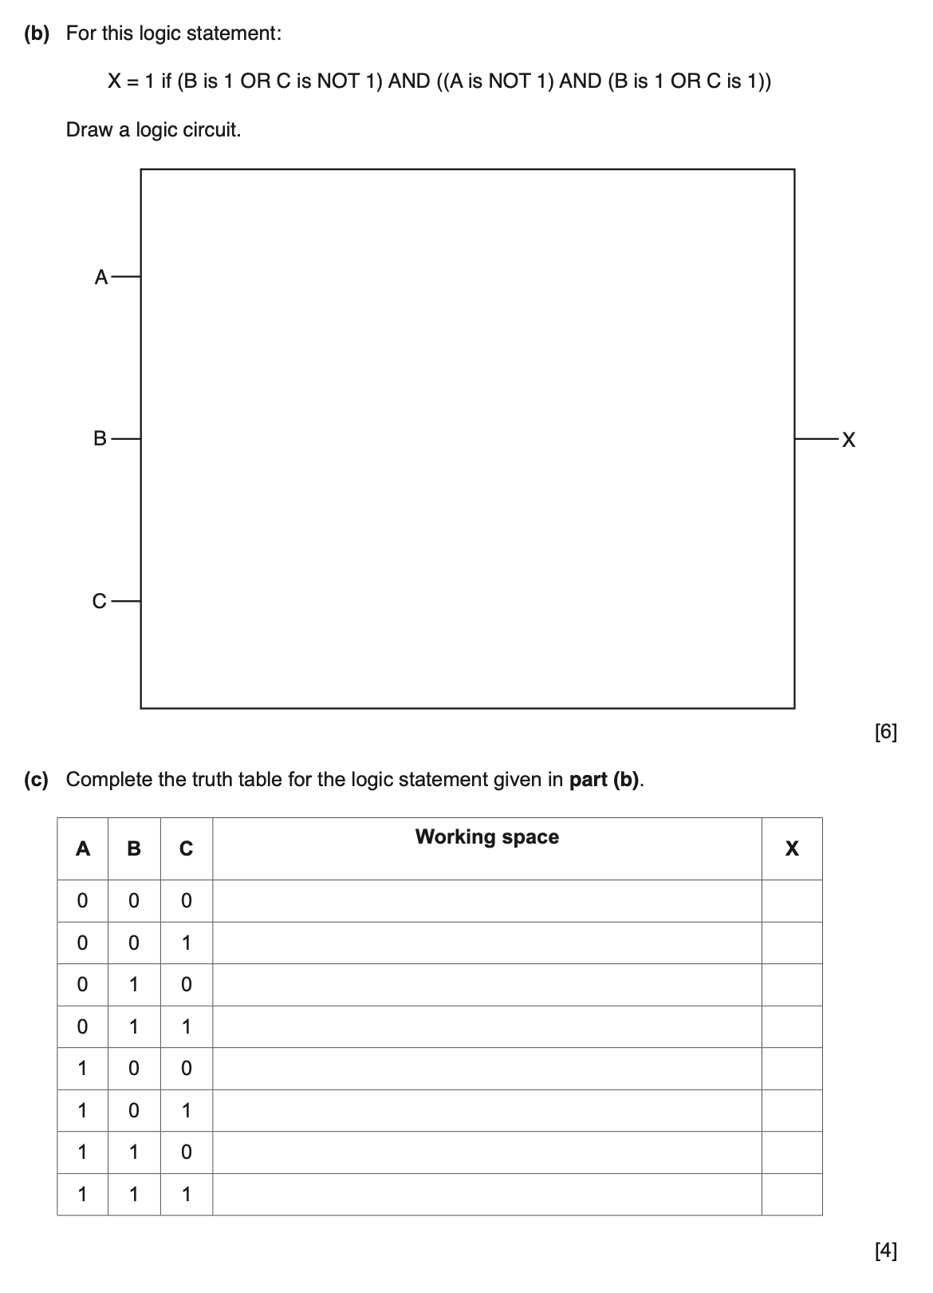
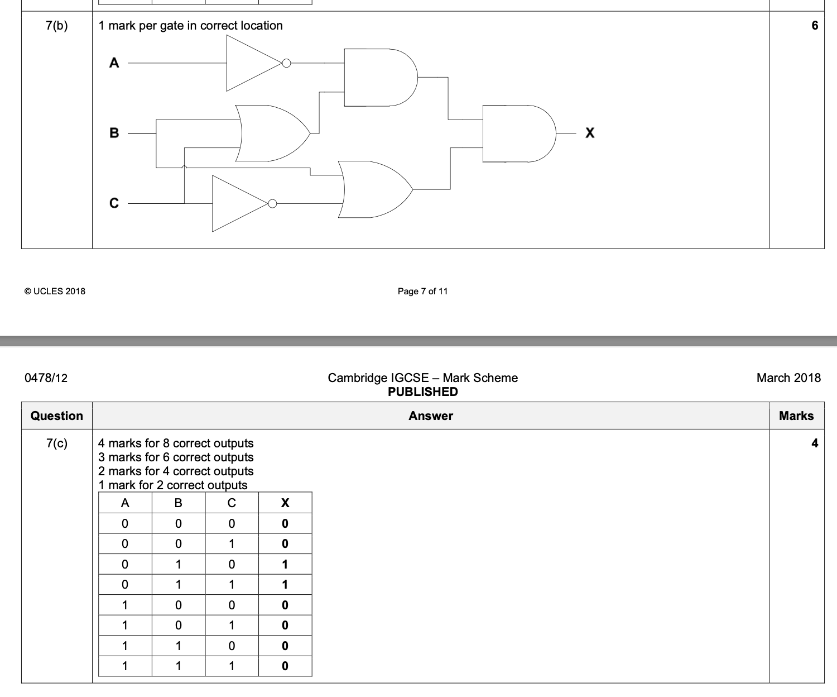

Slide 39
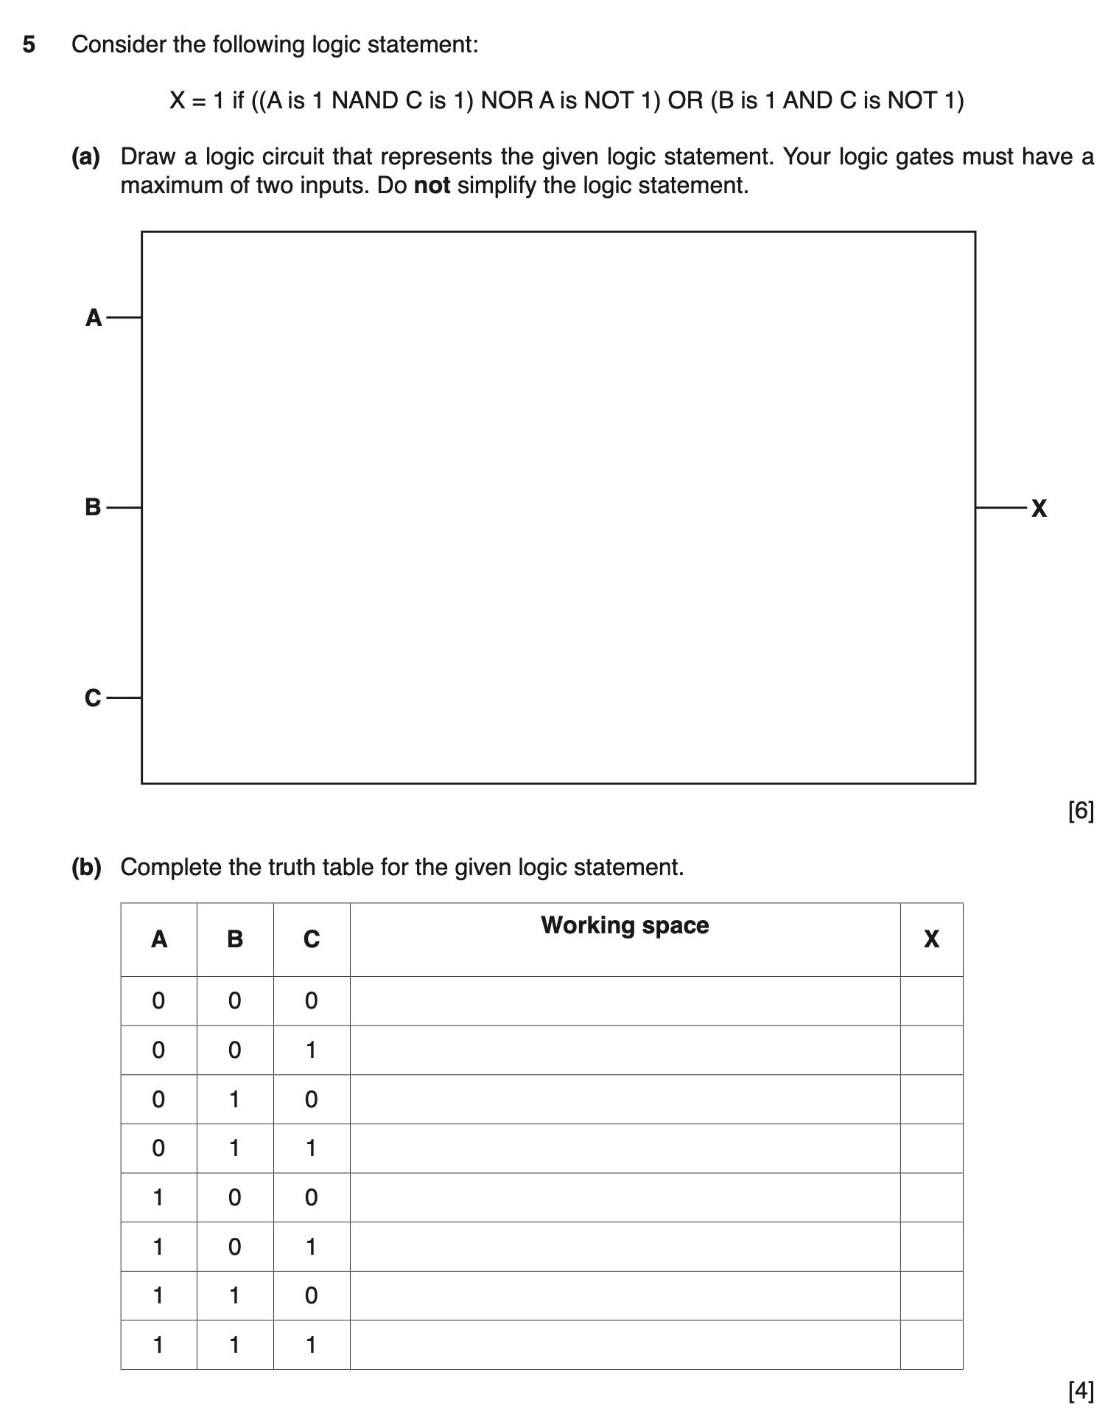
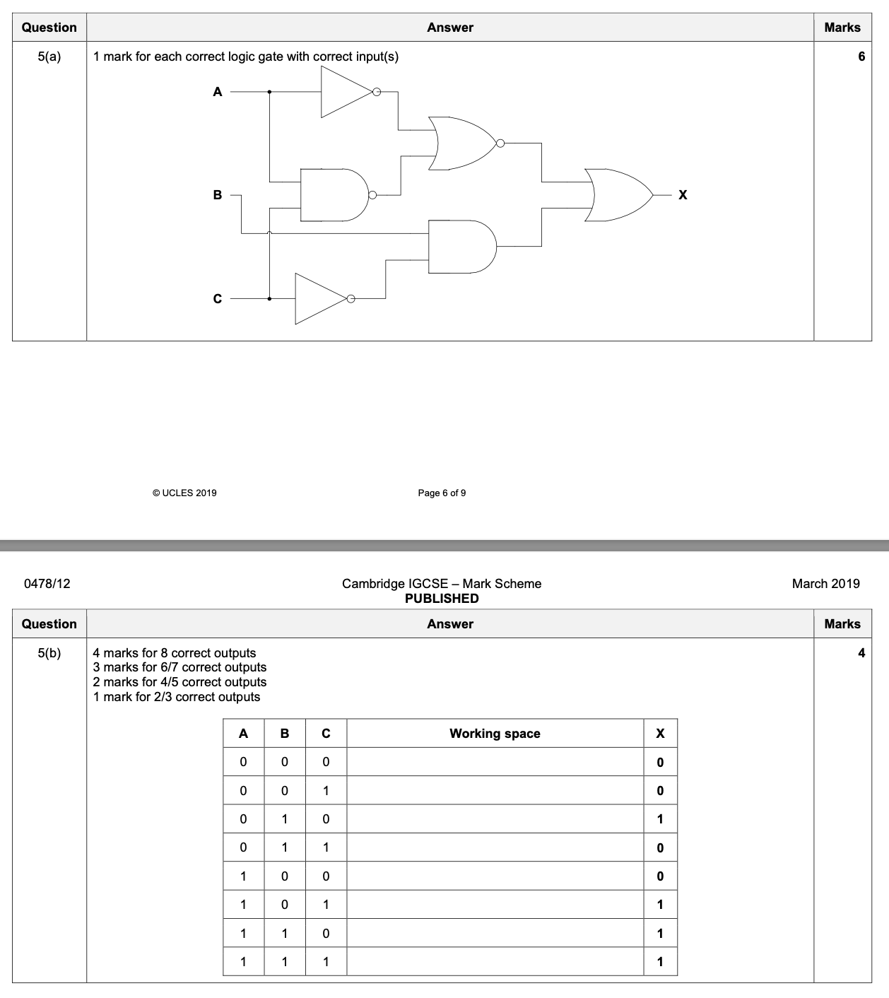

Slide 40
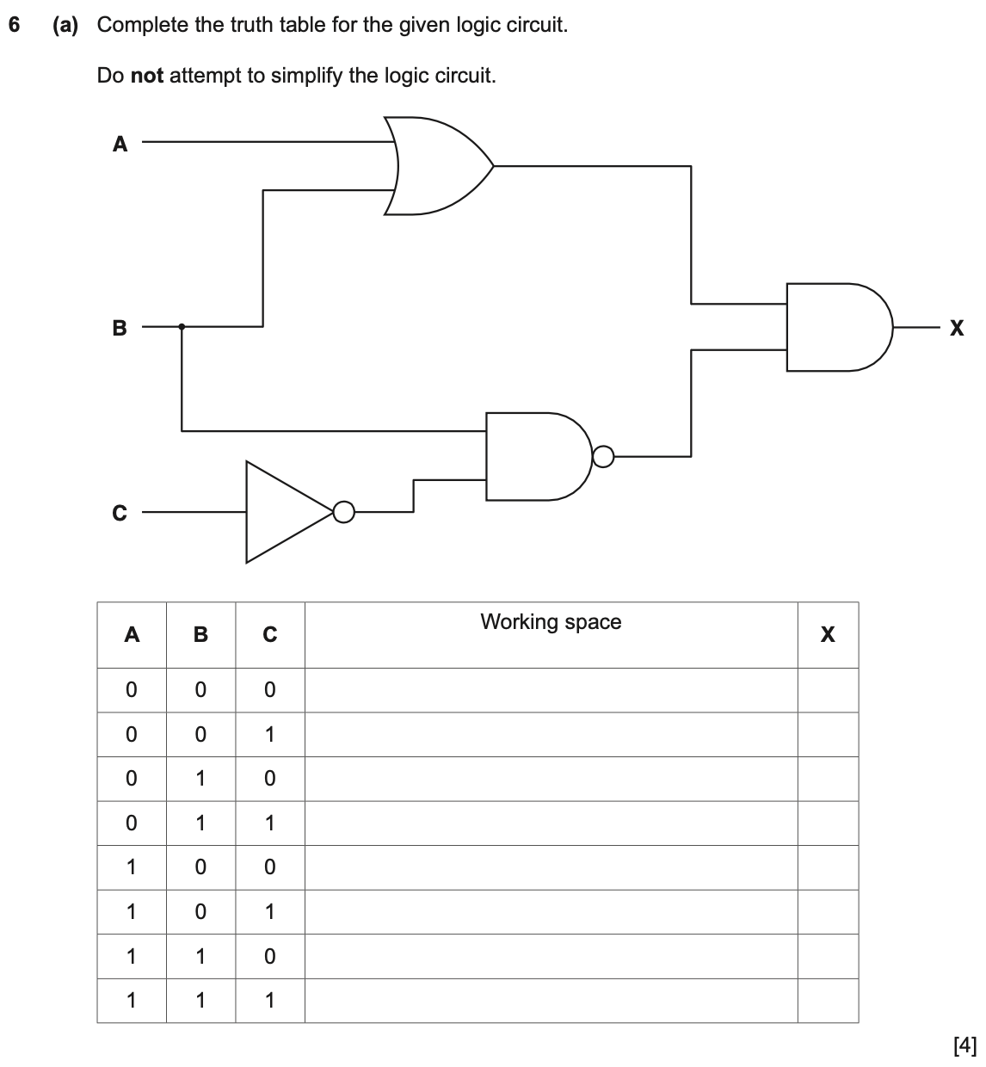
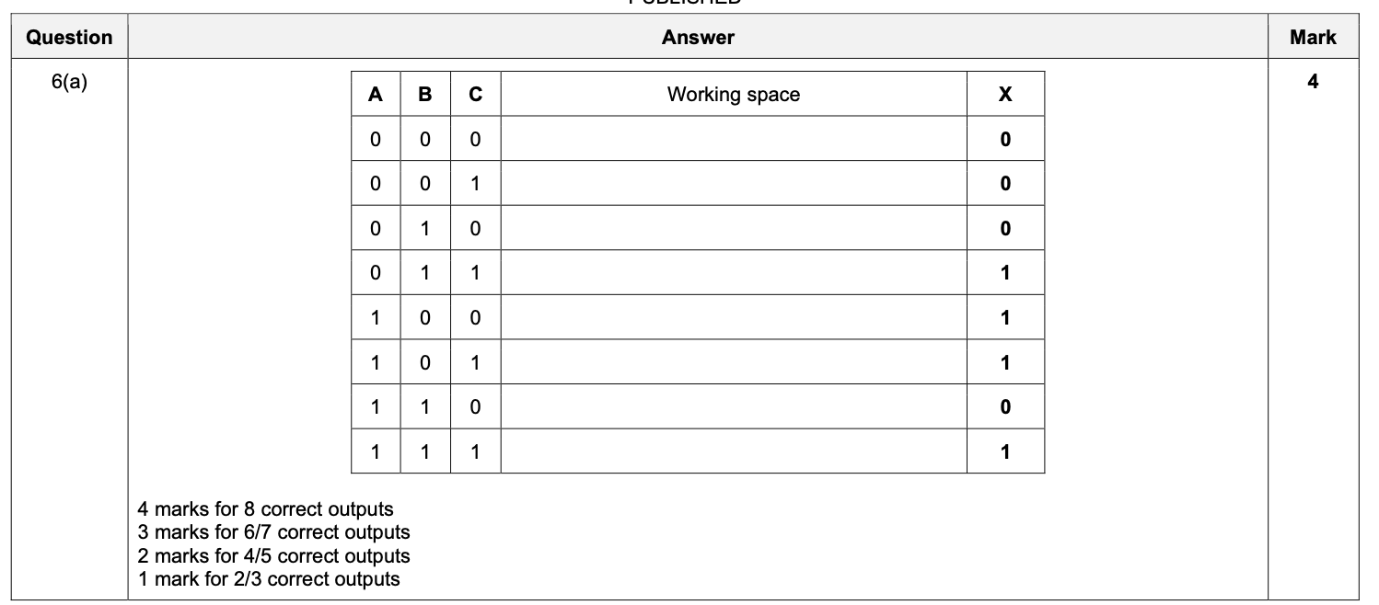

Slide 41
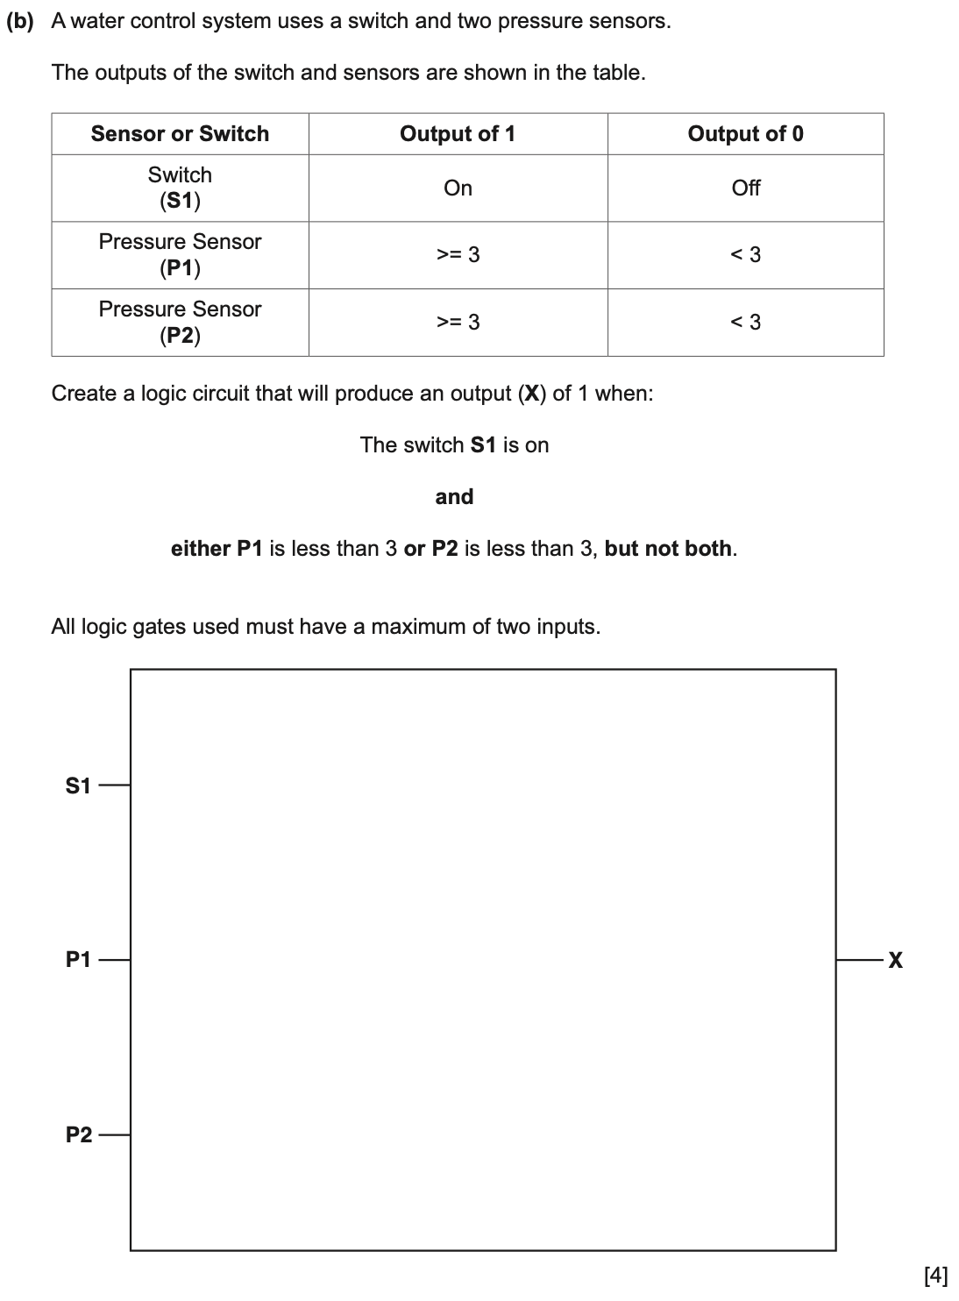
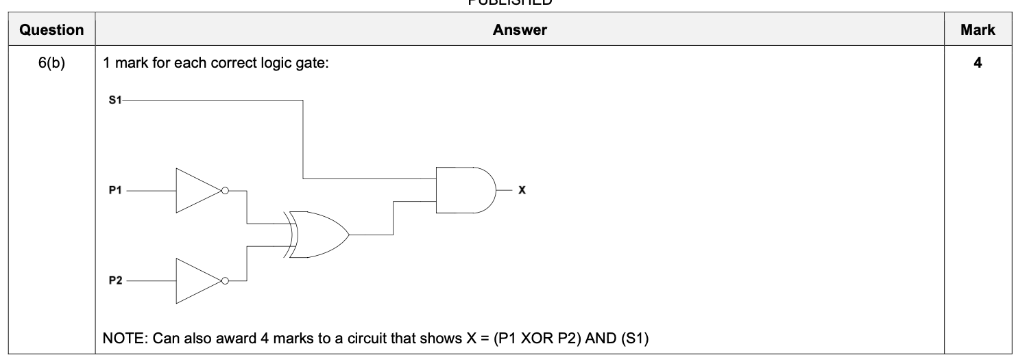

Slide 42
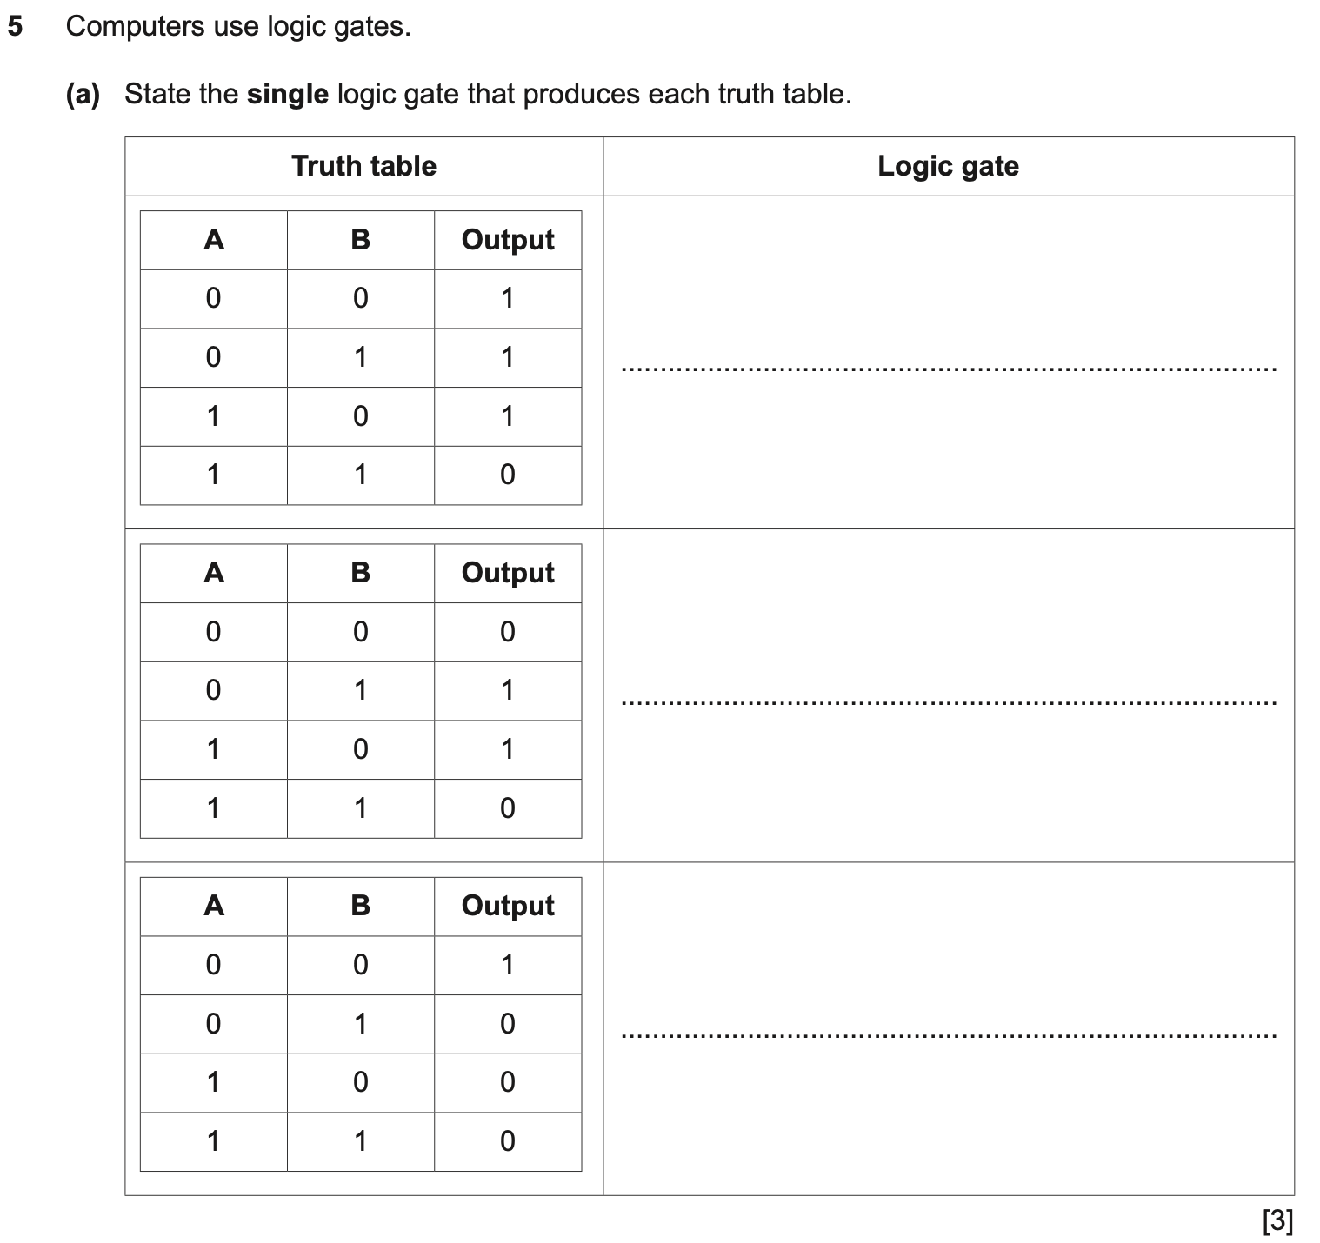
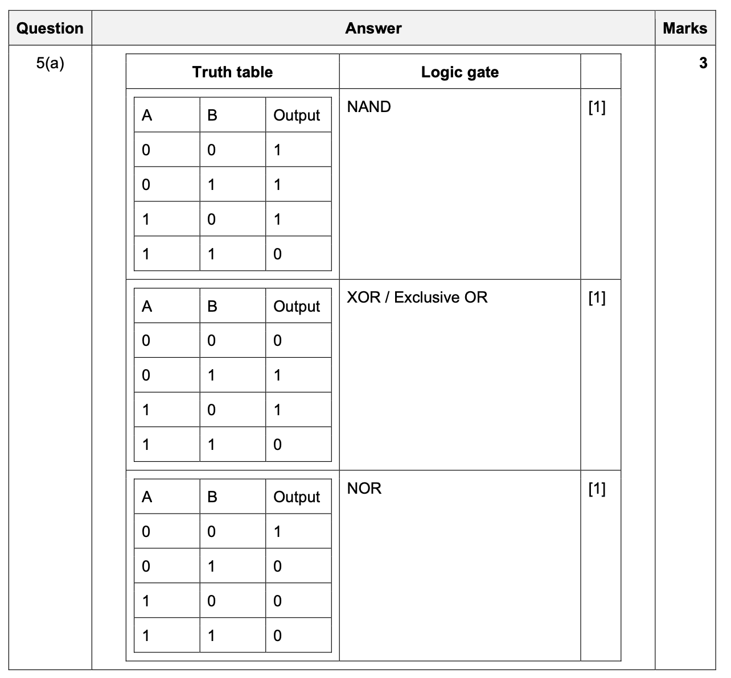

Slide 43
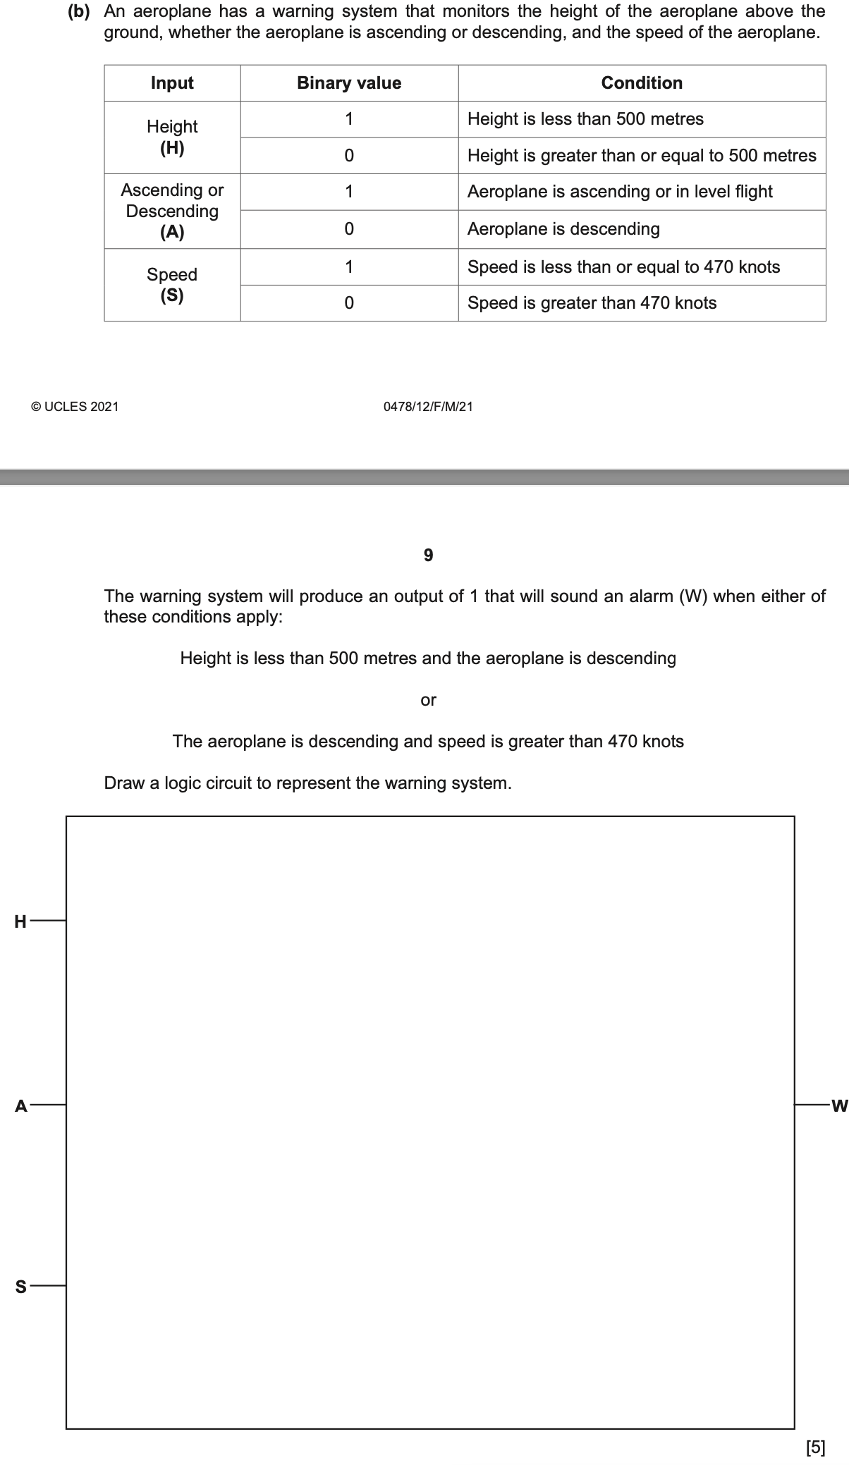
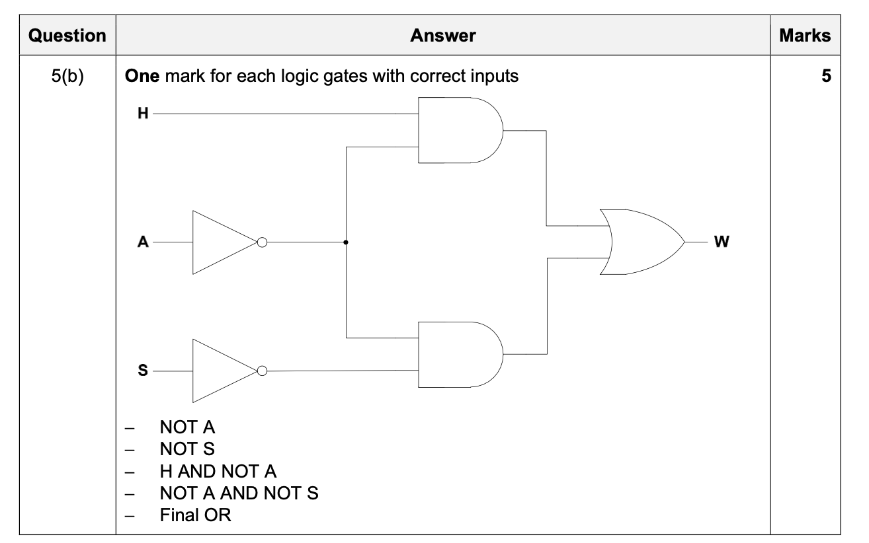

Slide 44
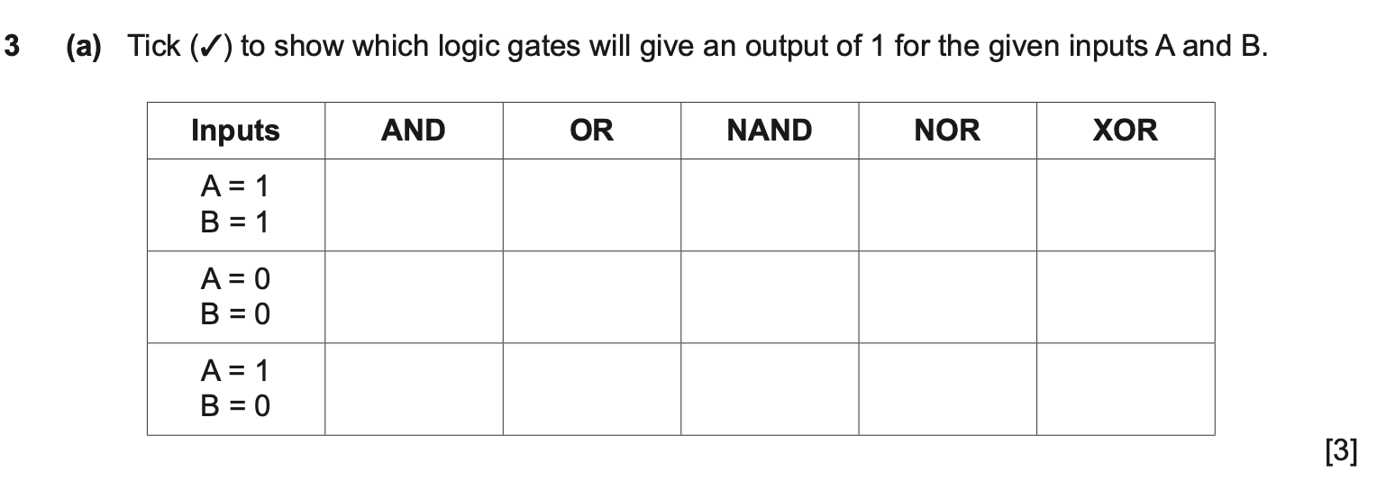
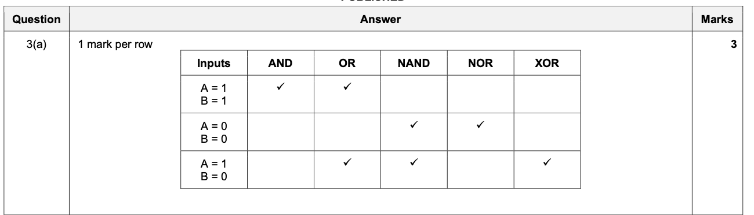

Slide 45
